Slide 1

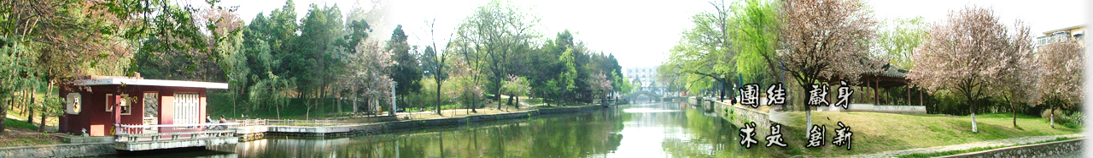
3 Architecture
EOE Postgraduate Courses
Multi-sensor Data Fusion
wangjingqi@njust.edu.cn

Slide 2
Contents
3.1 Introduction
3.2 Fusion Node
3.3 Simple Fusion Networks
3.4 Network Topology

Slide 3
3.1 Introduction
Architecture of the “data fusion block”
Fusion nodes ⎯ the modules in the data fusion block.
A communication system transfers information from one node to another node via an exchange of messages.
An algorithmic description of the fusion block embedded in the nodes determines the behavior of the block and coordinates its activities.
Transparency
Considering the data fusion block as a whole, transparency is concerned with the “concealment” of nodes in a distributed system.
Replication Transparency. To increase the reliability and performance of the system by using multiple copies of the same sensor. However the user, or the application program, has no knowledge of the duplicate sensors.
Failure Transparency. Failures are concealed in the hardware or software. The user, or the application program, has no knowledge of the failures.

Slide 4
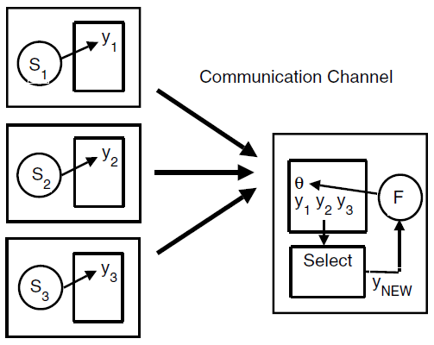
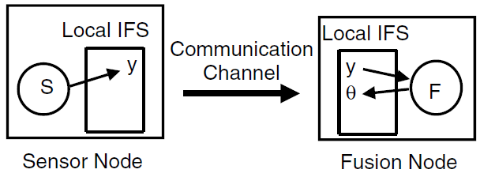
Example 3.1. Fault-Tolerant Framework.
Communication between a sensor node S and a fusion node F ⎯ the environmental image produced by F is sensitive to errors in the value y received from S.
Fig. 3.1 Communication and processing of data.
Fig. 3.2 Fault-tolerant communication and processing of data.
Fault-tolerant framework. We replace the sensor S by a set of M redundant sensors S_{m}, m ∈ {1, 2, . . .,M}, which produce a new y value which is less likely to be in error. The fusion algorithm remains unchanged.
□

Slide 5


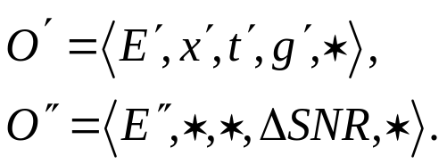
3.2 Fusion Node
input sensor observations
(2.1)
The observations and any a priori knowledge, → a common representational format → fused together to produce new output observations.
output observations
be always assigned new entity names,
may or may not differ in position (x), time (t), value (y) and uncertainty (Δy).
Example 3.2. Image Smoothing.
three input images I_{i}, i ∈ {1, 2, 3}, corresponding observations
an array of pixel gray-levels g_{i}.
generates two outputs:
a new image
a score function

Slide 6
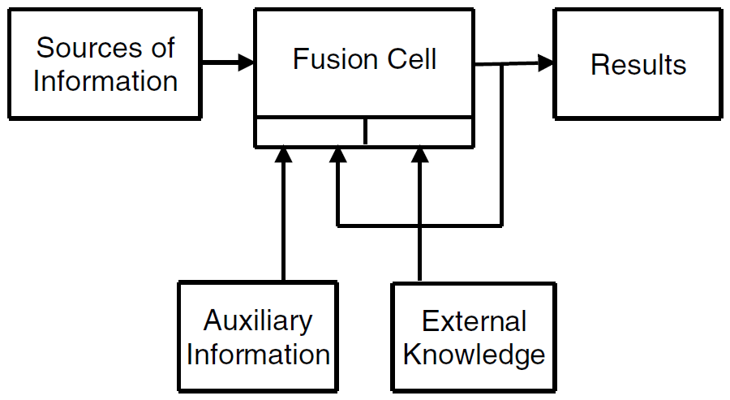
A graphical representation of a single fusion node
Input data types
Sensor Information ⎯ data which comes directly from the sensors S_{m},m ∈ {1, 2, . . .,M}, or input produced by other fusion cells.
Auxiliary Information. ⎯ additional data derived by specific processing of the sensor information.
External Knowledge. ⎯ additional data and consists of all the elements of the a priori, or external, knowledge.
Feedback of the results be viewed as auxiliary info.
Fig. 3.3 Single fusion node, its three types of input data.

Slide 7
Example 3.3. Sensor Information vs. Auxiliary Information.
The fusion cell F receives information from two sensors, S₁ and S₂, and from two fusion cells, F₁ and F₂, in the form of the results R₁ and R₂.
In classifying R₁ and R₂ we have two options:
  (1) F₁ and F₂ = logical sensors
  R₁ and R₂ = sensor information
  (2) F₁ and F₂ = specific processing sensors
  → R₁ and R₂ = auxiliary information.

Slide 8
3.2.1 Properties of the fusion node
Common Structure. - each node has the same structure. - can easily implement and modify all nodes.
Complete. - node possessing all the information; - some information, received through a communications channel.
Relevant. - Each node only has information relevant to its functions
Uncertainty. - Observation error and noise → the information in a node is uncertain.
Communication. - Individual nodes are only able to communicate with other nodes that are directly connected to it.
Self-Identification. - the node ability to automatically identify itself.
Self-Testing. - the process of inspection and verification to ensure the node be functioning properly. - node is able to inform the network about its condition and thus avoid corrupting the system with wrong data.

Slide 9
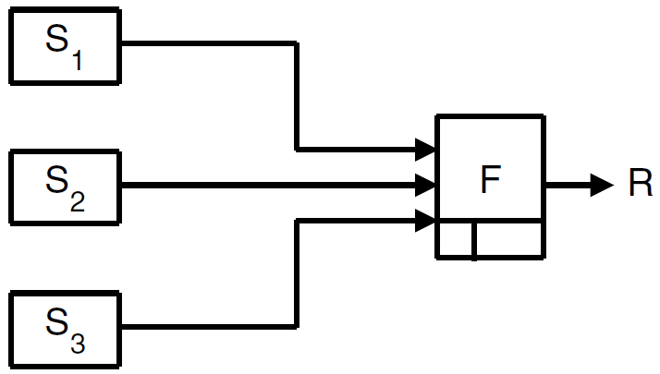
3.3 Simple Fusion Networks
3.3.1 Single Fusion Cell
The simplest multi-sensor fusion network consists of a single fusion cell.
may be used to fuse together raw sensor measurements.

Slide 10
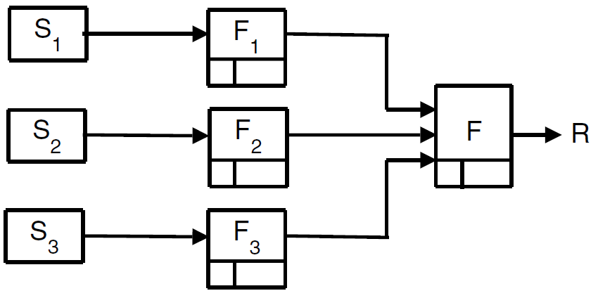
3.3.2 Parallel Network
each fusion cell F_{m}, m∈{1, 2, … , M}, separately processes the input data which is received from the sensor S_{m} and delivers its results R_{m} to a fusion process F which generates the final result R.
Typically, the intermediate result R_{m}, m∈{1, 2, …,M}, are redundant, and the fusion process F is used to increase reliability and accuracy of the final result R.
Fig. 3.4 Parallel arrangement of three fusion cells

Slide 11
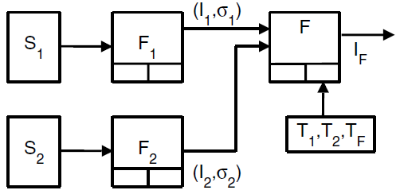
Example 3.4. Tire Pressure Monitoring Device.
indirectly measure the tire pressure using two existing sensors.
Vibration Sensor S₁. - the rubber in the tire reacts like a spring when excited by road roughness. - to monitor the resonance frequency which in turn is correlated with the tire pressure.
Wheel Radius Sensor S₂. - The tire pressure affects the rolling radius of the tire. - to monitor the difference in wheel speeds, which should be close to zero when the tires are equally large.
S₁ , the resonance frequency, F₁ , variables (I₁, σ₁).
S₂ , the wheel radii, F₂, variables (I₂, σ₂).
thresholds T₁, T₂, T_{F} - “external knowledge”.
Fig. 3.5 Operation of the new tire pressure monitoring system.
□

Slide 12
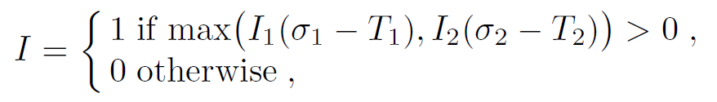
- two fusion cells F_{m}, m ∈ {1, 2} , two variables:
(1) a flag, or indicator, I_{m}, to indicate whether, or not, the tire is under-inflated,
(2) a confidence σ_{m} associated with I_{m}.
The two pairs of variables can be used independently
fusing the two sets of measurements in a simple voting scheme, the fused indicator I_{F},

Slide 13
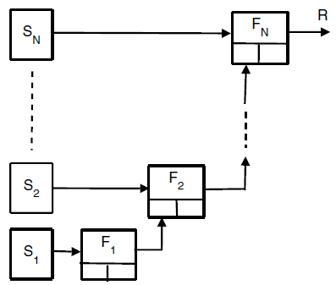
3.3.3 Serial Network
each cell F_{n}, n∈{1, 2, …, N-1}, receives one, or more, observations from the sensor S_{n} and it sends its results R_{n} to the next cell F_{n+1}.
typically, the intermediate results R_{n}, n ∈ {1, 2, …, N}, are heterogeneous and complementary.
Fig. 3.6 Serial arrangement of multiple fusion cells.

Slide 14
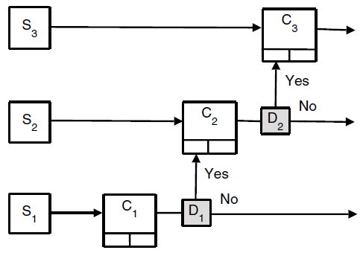
Example 3.5. Multi-Modal Biometric Identification Scheme.
serial architecture can improve the user convenience as well as allow fast and efficient searches in appropriate databases.
For example, suppose, after processing the first k biometric features, we have sufficient confidence concerning the identity of the user. At this point, we may stop the process and the user will not be required to provide the remaining biometric features.
three-stage biometric identification scheme.
decision boxes D₁,and D₂ are used to determine whether or not a biometric measurement from sensor S₂ or S₃ is required.
Fig. 3.7 Serial arrangement of multiple classification cells C_{m}, m ∈ {1, 2, 3}.
□

Slide 15
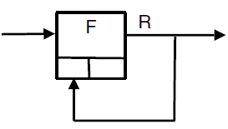
3.3.4 Iterative Network
re-introducing the result R as auxiliary knowledge into the fusion cell F.
generally used to possess dynamical data sources.
temporal tracking of objects in an image sequence, or the navigation of a mobile robot.
F could be, for example, a Kalman filter.
The result R is re-introduced as auxiliary knowledge into F.
Fig. 3.8 Single fusion cell operating in an iterative mode.

Slide 16
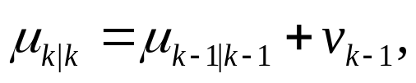

Example 3.6. Heart-Rate Estimation using a Kalman Filter.
Adaptive estimation of the mean heart rate using a one-dimensional Kalman filter.
Given the sequence of measured heart-rates y_{1:k} = (y₁, y₂, . . . , y_{k}), μ_{k|k} denote the estimated mean heart rate at time step k,
v_{k−1} ∼ N(0,Q) ⎯⎯ the process noise at time step k − 1.
y_{k} ⎯ the measured heart-rate at time step k :
w_{k} ∼ N(0,R) ⎯ the measurement noise.

Slide 17
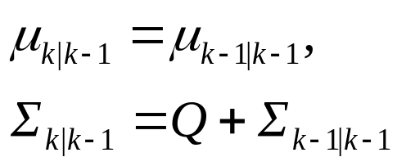
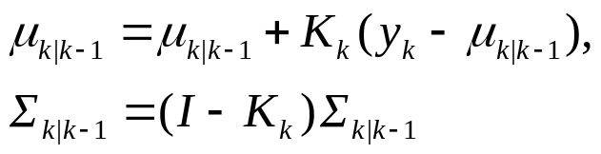
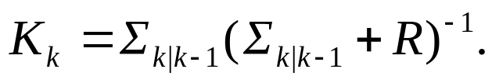
The Kalman filter estimates μ_{k|k} in a predictor/corrector algorithm:
In the prediction phase we project the filtered heart rate μ_{k−1|k−1} and its covariance matrix Σ_{k−1|k−1} to the next time step k.
μ_{k|k−1} and Σ _{k|k−1} ⎯⎯ the corresponding predicted values.
In the correction phase we fuse the predicted values with the measurement y_{k} made at the kth time step:
where I is a unit matrix and

Slide 18
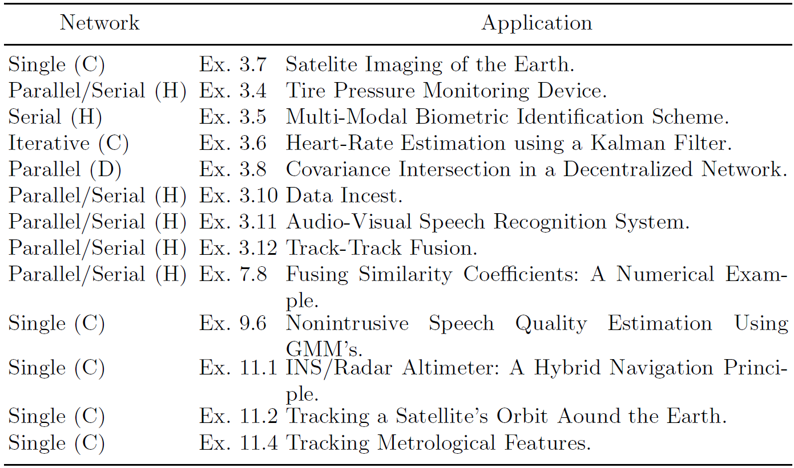
3.4 Network Topology
three different topologies, or architectures: centralized, decentralized and hierarchical.
Table 3.1. Multi-Sensor Data Fusion Applications: Their Networks and Architectures

Slide 19
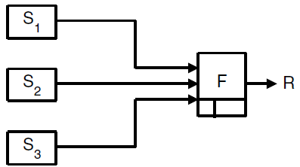
3.4.1 Centralized
F is treated as a central processor
collects all information from the different sensors.
making all decisions; giving out instructions, or task assignments to the respective sensors.
Theoretically, a single fusion node has the best performance if all the sensors are accurately aligned.
Fig.3.9 Operation of a centralized node F. The inputs to F are regarded as being produced by separate logical sensors S₁, S₂, S₃.
Small errors in the correct sensor alignment may cause substantial reduction in the performance of the fusion!

Slide 20
Other drawbacks
Communication.
All sensors communicate directly with the centralized fusion node. This may cause a communication bottleneck.
Inflexibility.
If the application changes, the centralized system may not easily adapt.
Vulnerability.
If there is a failure in the central processor, or the central communications facility, the entire system fails.
Non-modularity.
If more sensors are added to a centralized system, some reprogramming is generally required: The communications bandwidth and computer power would need to increase (assuming a fixed total processing time constraint) in proportion to the amount of extra data.

Slide 21
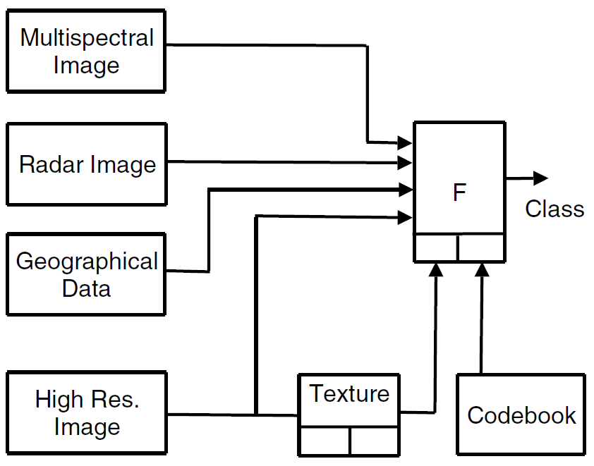
Example 3.7. Satellite Imaging of the Earth.
The fusion method is a classifier.
The output is a segmented image showing the distribution of the different classes.
Centralized architecture.
The texture information produced by a specific processing of image as auxiliary information.
The codebook used as external knowledge.
Fig.3.10 Mapping of a landscape using Earth observation satellite images.

Slide 22
3.4.2 Decentralized
using a set of local fusion nodes
Main advantage: be lack of sensitivity regarding the correct alignment of the sensors.
Other advantages
Communication. ⎯ relatively immune to communication and signal processing bottlenecks due to the reduction of information flow between nodes, and distributed data processing load.
Scalable. ⎯ be scalable in structure without being constrained by centralized computational bottleneck or communication bandwidth limitations.
Robustness. ⎯ be robust against loss of nodes and changes in the network.
Modular Design. ⎯ be modular in the design and implementation of the fusion nodes.

Slide 23
Effects of redundant information
old
A
B
new
Processing the redundant information under the assumption of independence, then it would wrongly decrease the uncertainty in the fused information.
Theoretically, we keep track of all the information − not practical
The method of covariance intersection is one algorithm being robust against redundant .

Slide 24
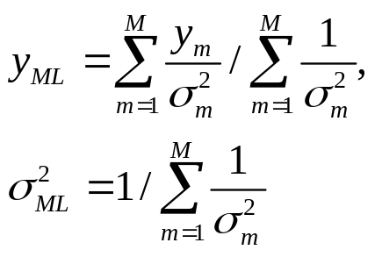
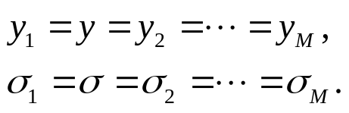
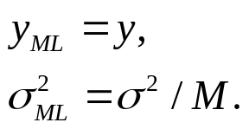
Example 3.8. Covariance Intersection in a Decentralized Network
Considering a given node F in a decentralized network receives the same piece of information from m different sources S_{m}, m ∈ {1, 2, …, M}.
information ⎯ a scalar measurement y_{m}, and an uncertainty σ²_{m}
under the assumption of independence, the corresponding fused maximum likelihood measurement value and uncertainty are given by:
For the same piece of information ,
The 1/M reduction in uncertainty is clearly incorrect!

Slide 25
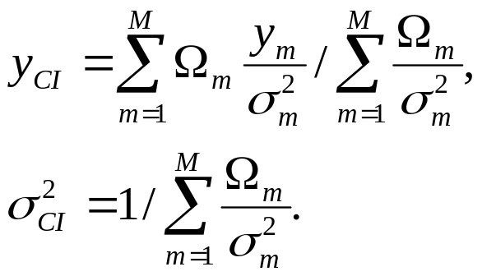

Covariance Intersection Method
Fusing the measurements y_{m}, m ∈ {1, 2, …, M}, with a weighted maximum likelihood estimate.
The weights Ω_{m} : Ω_{m} ≥ 0 and Σ Ω_{m} = 1.
Corresponding fused estimate and uncertainty are
Assuming the Ω_{m} are all equal to 1/M, then
There is no reduction in uncertainty!

Slide 26
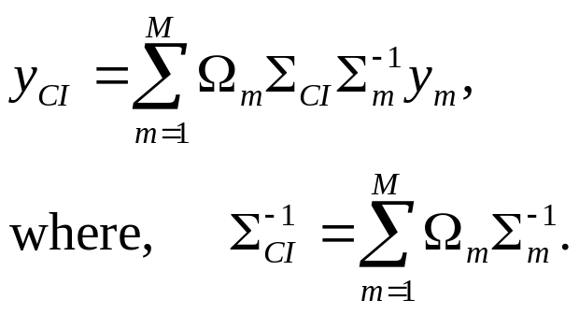
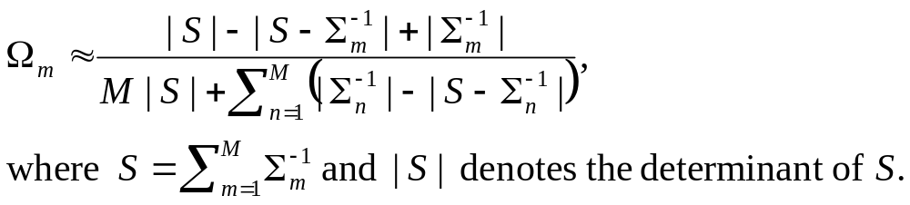
General Covariance Intersection Method
Multi-dimensional measurements y_{m}, m ∈ {1, 2, …, M}, with covariance matrices Σ_{m},
A fast algorithm for calculating the Ω_{m},

Slide 27
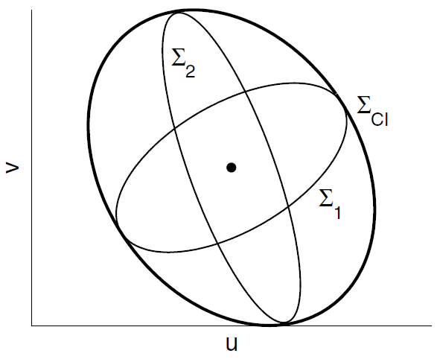



Example 3.9. Covariance Intersection of Two 2D Observations
Fig.3.11 The covariance of two coincident sensor observations O1 and O2 in two dimensions (u, v).
A small filled circle ⎯ the position of the observations
The covariances, Σ₁ and Σ₂
The covariance of the covariance intersection, Σ_{CI}

Slide 28
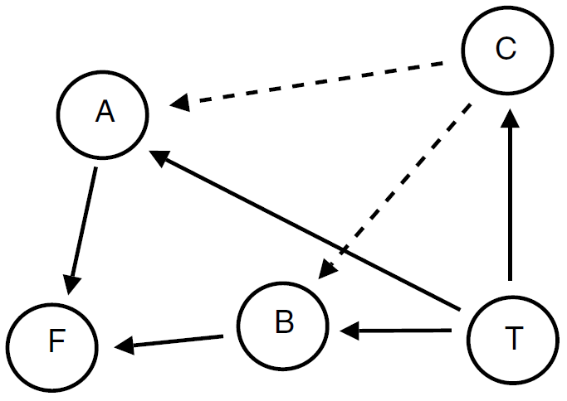
3.4.3 Hierarchical
Mixing together the centralized and decentralized systems.
Combining the advantages of the centralized and decentralized architectures without some of their disadvantages. E.g., relatively insensitive to any errors in the correct alignment of the sensors.
The effects of redundant information, or data incest.
Example 3.10. Data Incest
C can only relay its information to F via A or B.
C broadcasts its information to both A and B.
when the sensor C successfully sends its information regarding the target T to A and B which in turn forward the information onto the fusion cell F
→ data incest !

Slide 29
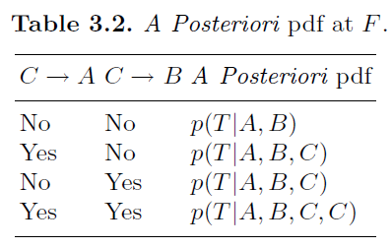
The a posteriori probability density function
from C to A (via the channel C → A)
from C to B (via the channel C → B)
Data incest only occurs when both C → A and C → B are successful and the corresponding a posteriori pdf is p(T |A,B,C,C).

Slide 30
Implementation of a fusion system using a hierarchical architecture.
There are often several hierarchical levels where the top level contains a single centralized fusion node and last level is made up of several decentralized (local) fusion nodes.
Each of the local fusion nodes may receive inputs from a small group of sensors or from an individual sensor.

Slide 31
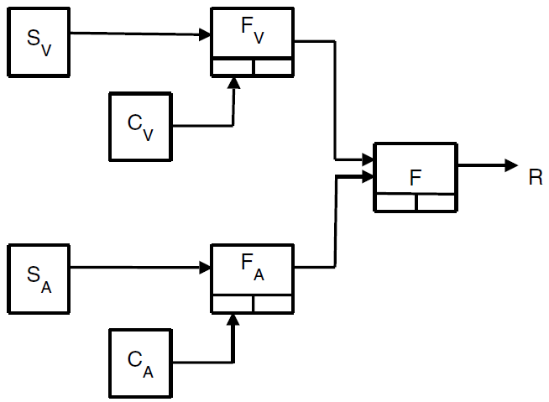
Example 3.11. Audio-Visual Speech Recognition System
a single central fusion node F which receives input from an audio fusion node F_{A} and a visual fusion node F_{V}.
raw sensor data from the audio and visual sensors S_{A} and S_{V}
auxiliary data from the secondary classifiers C_{A} and C_{V}.
Fig.3.13 The hierarchical architecture for an audio-visual speech recognition system.

Slide 32
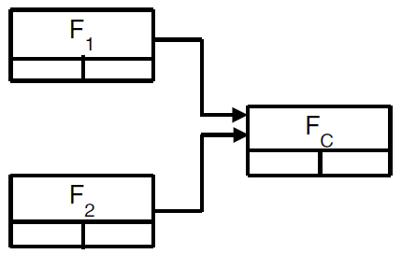
Example 3.12. Track-to-Track Fusion
two local fusion nodes F₁ and F₂ which form local tracks T₁ and T₂ using the observations received from the sensors S₁ and S₂.
the local tracks are sent to the central fusion node F_{C} where they are fused together into a single track T_{C}.
Fig.3.14 The hierarchical architecture for a track-to-track fusion system.

Slide 33

Thank you for your attention!

